Slide 1
The Thirteen Colonies
Part 3-
Life in Colonial New England

Slide 2
Economics of New England

Slide 3
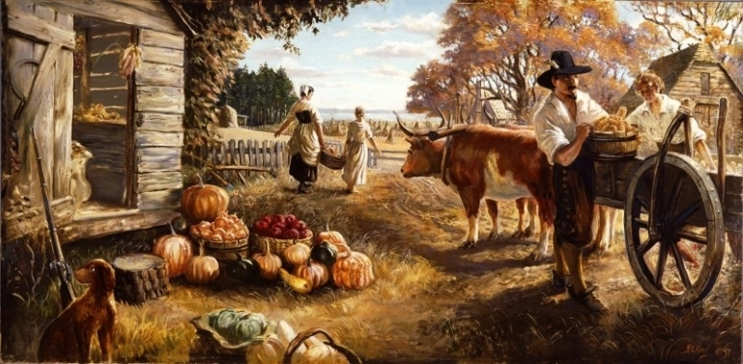
Most of the early settlers of the New England colonies were farmers.

Slide 4
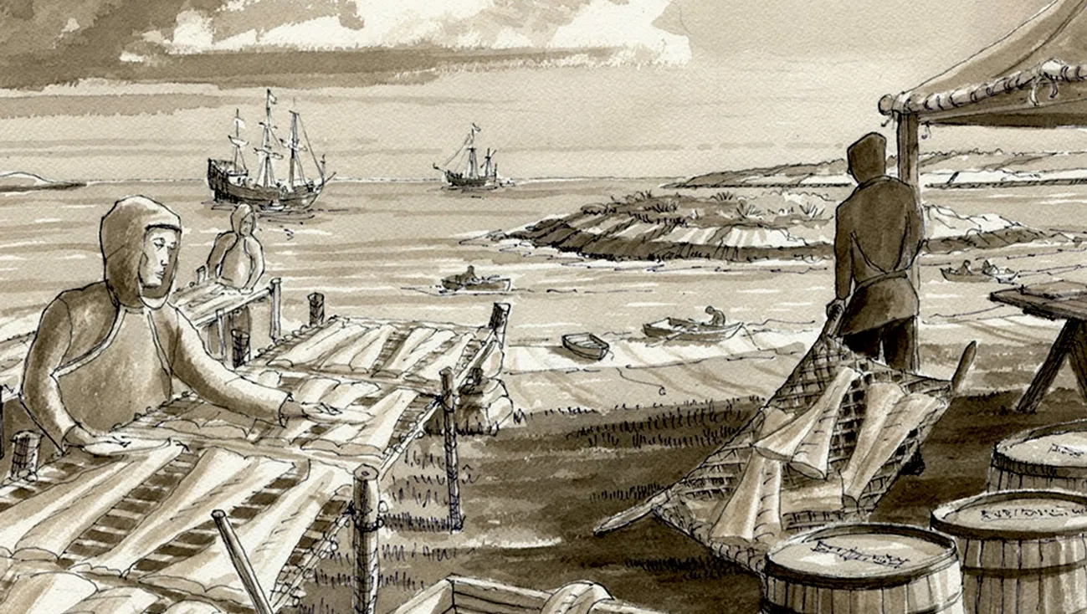
Soon many New Englanders turned to the sea as their way of life.

Slide 5
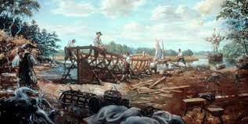
The waters off the Atlantic coast of New England provided some of the best fishing grounds in the world, and the forests on land provided the needed lumber to build the fishing boats.

Slide 6
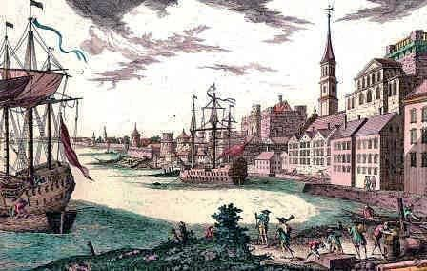
Fishing and shipbuilding encouraged trade which helped make Boston the largest and richest colonial town in America by 1700.

Slide 7
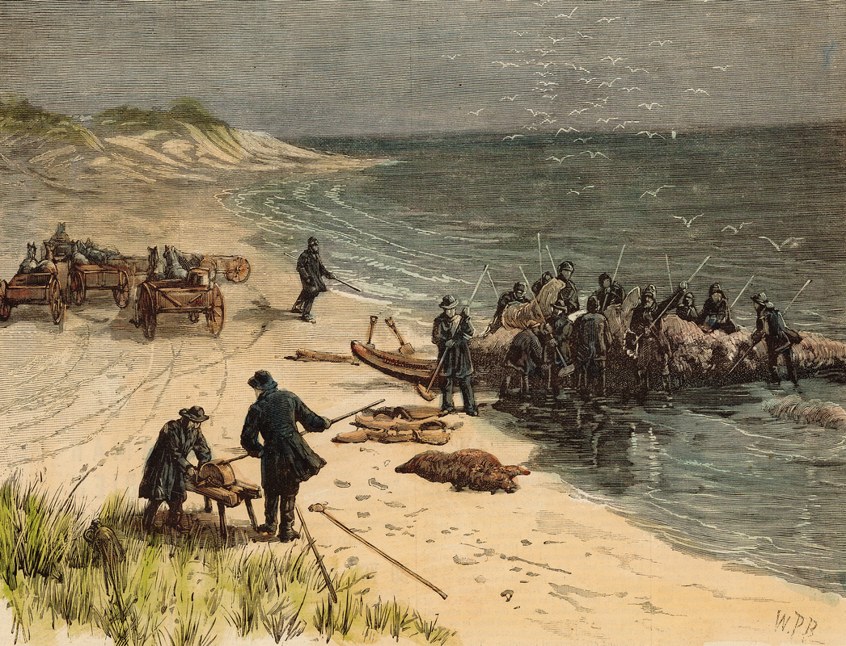
Whaling also became an important activity. Whale blubber was turned into oil to burn in lamps and whalebone were used to make things like umbrellas, hairbrushes, and corsets.

Slide 8
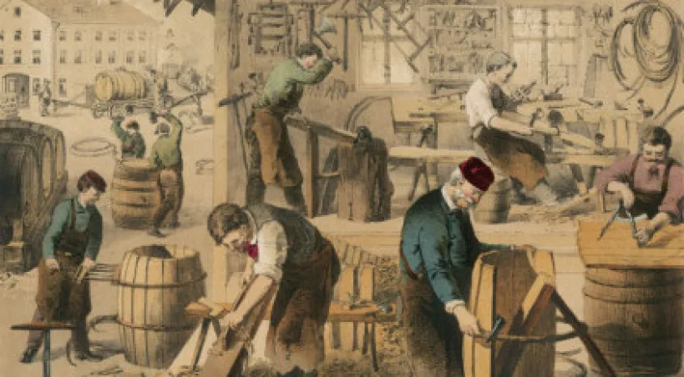
Many fisherman and whalers, when not at sea, were coopers, or barrel makers. These barrels were necessary for storing and shipping whale oil.

Slide 9
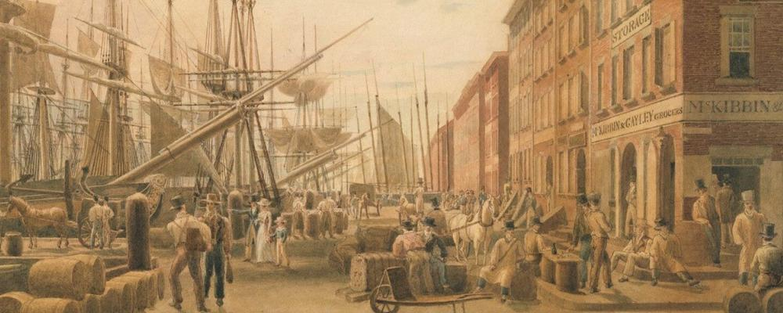
Many New Englanders were also traders. They would transport goods up and down the Atlantic coast and across the Atlantic Ocean.

Slide 10
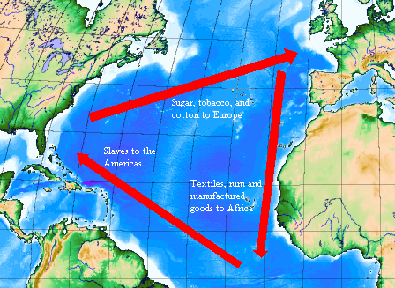
One of these trade routes was called the triangular trade route.
Triangular Trade Route

Slide 11
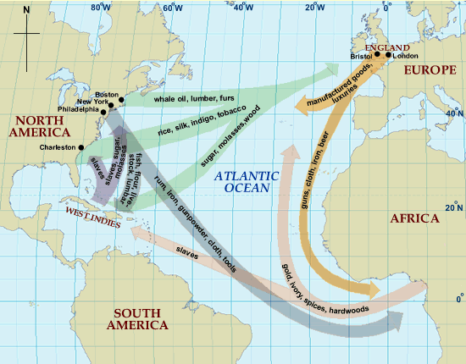

Slide 12
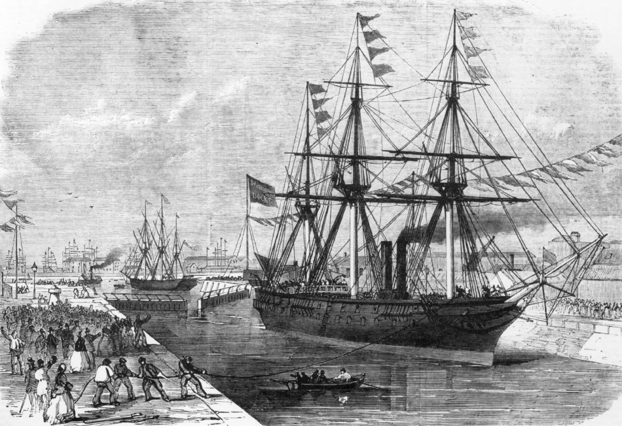
One of the reasons England wanted the colonies in America was to help make England rich. They tried to control the trade of the American colonies by creating laws in 1651 called the Navigation Acts.

Slide 13
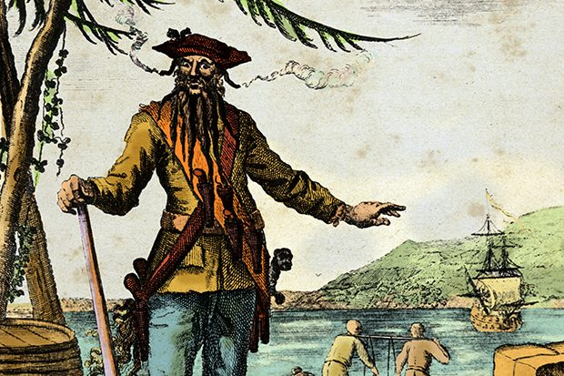
At times colonists tried to import or export goods by smuggling them illegally. Piracy occurred often during the late 1600s.

Slide 14
Social Aspects of New England

Slide 15
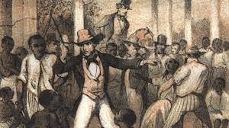
There was little slavery in the New England colonies. This is mainly because there was little need for large numbers of unskilled labor.

Slide 16
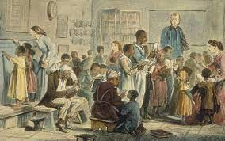
The few slaves in New England were generally treated better than those slaves living in the South. Often times they were even taught how to read and write.

Slide 17
There were more free blacks living in New England than anywhere else in the colonies. Even so, they were usually not treated as equals to whites.

Slide 18
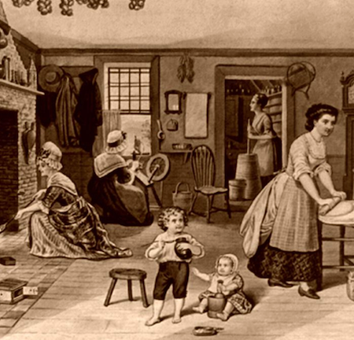
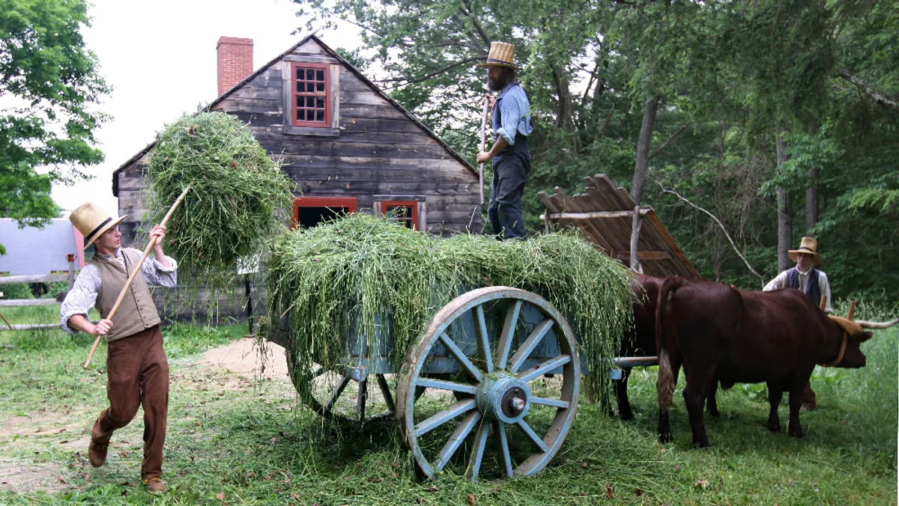
Men and boys did most of the outdoor work in the New England colonies. Women and girls did the household jobs.

Slide 19
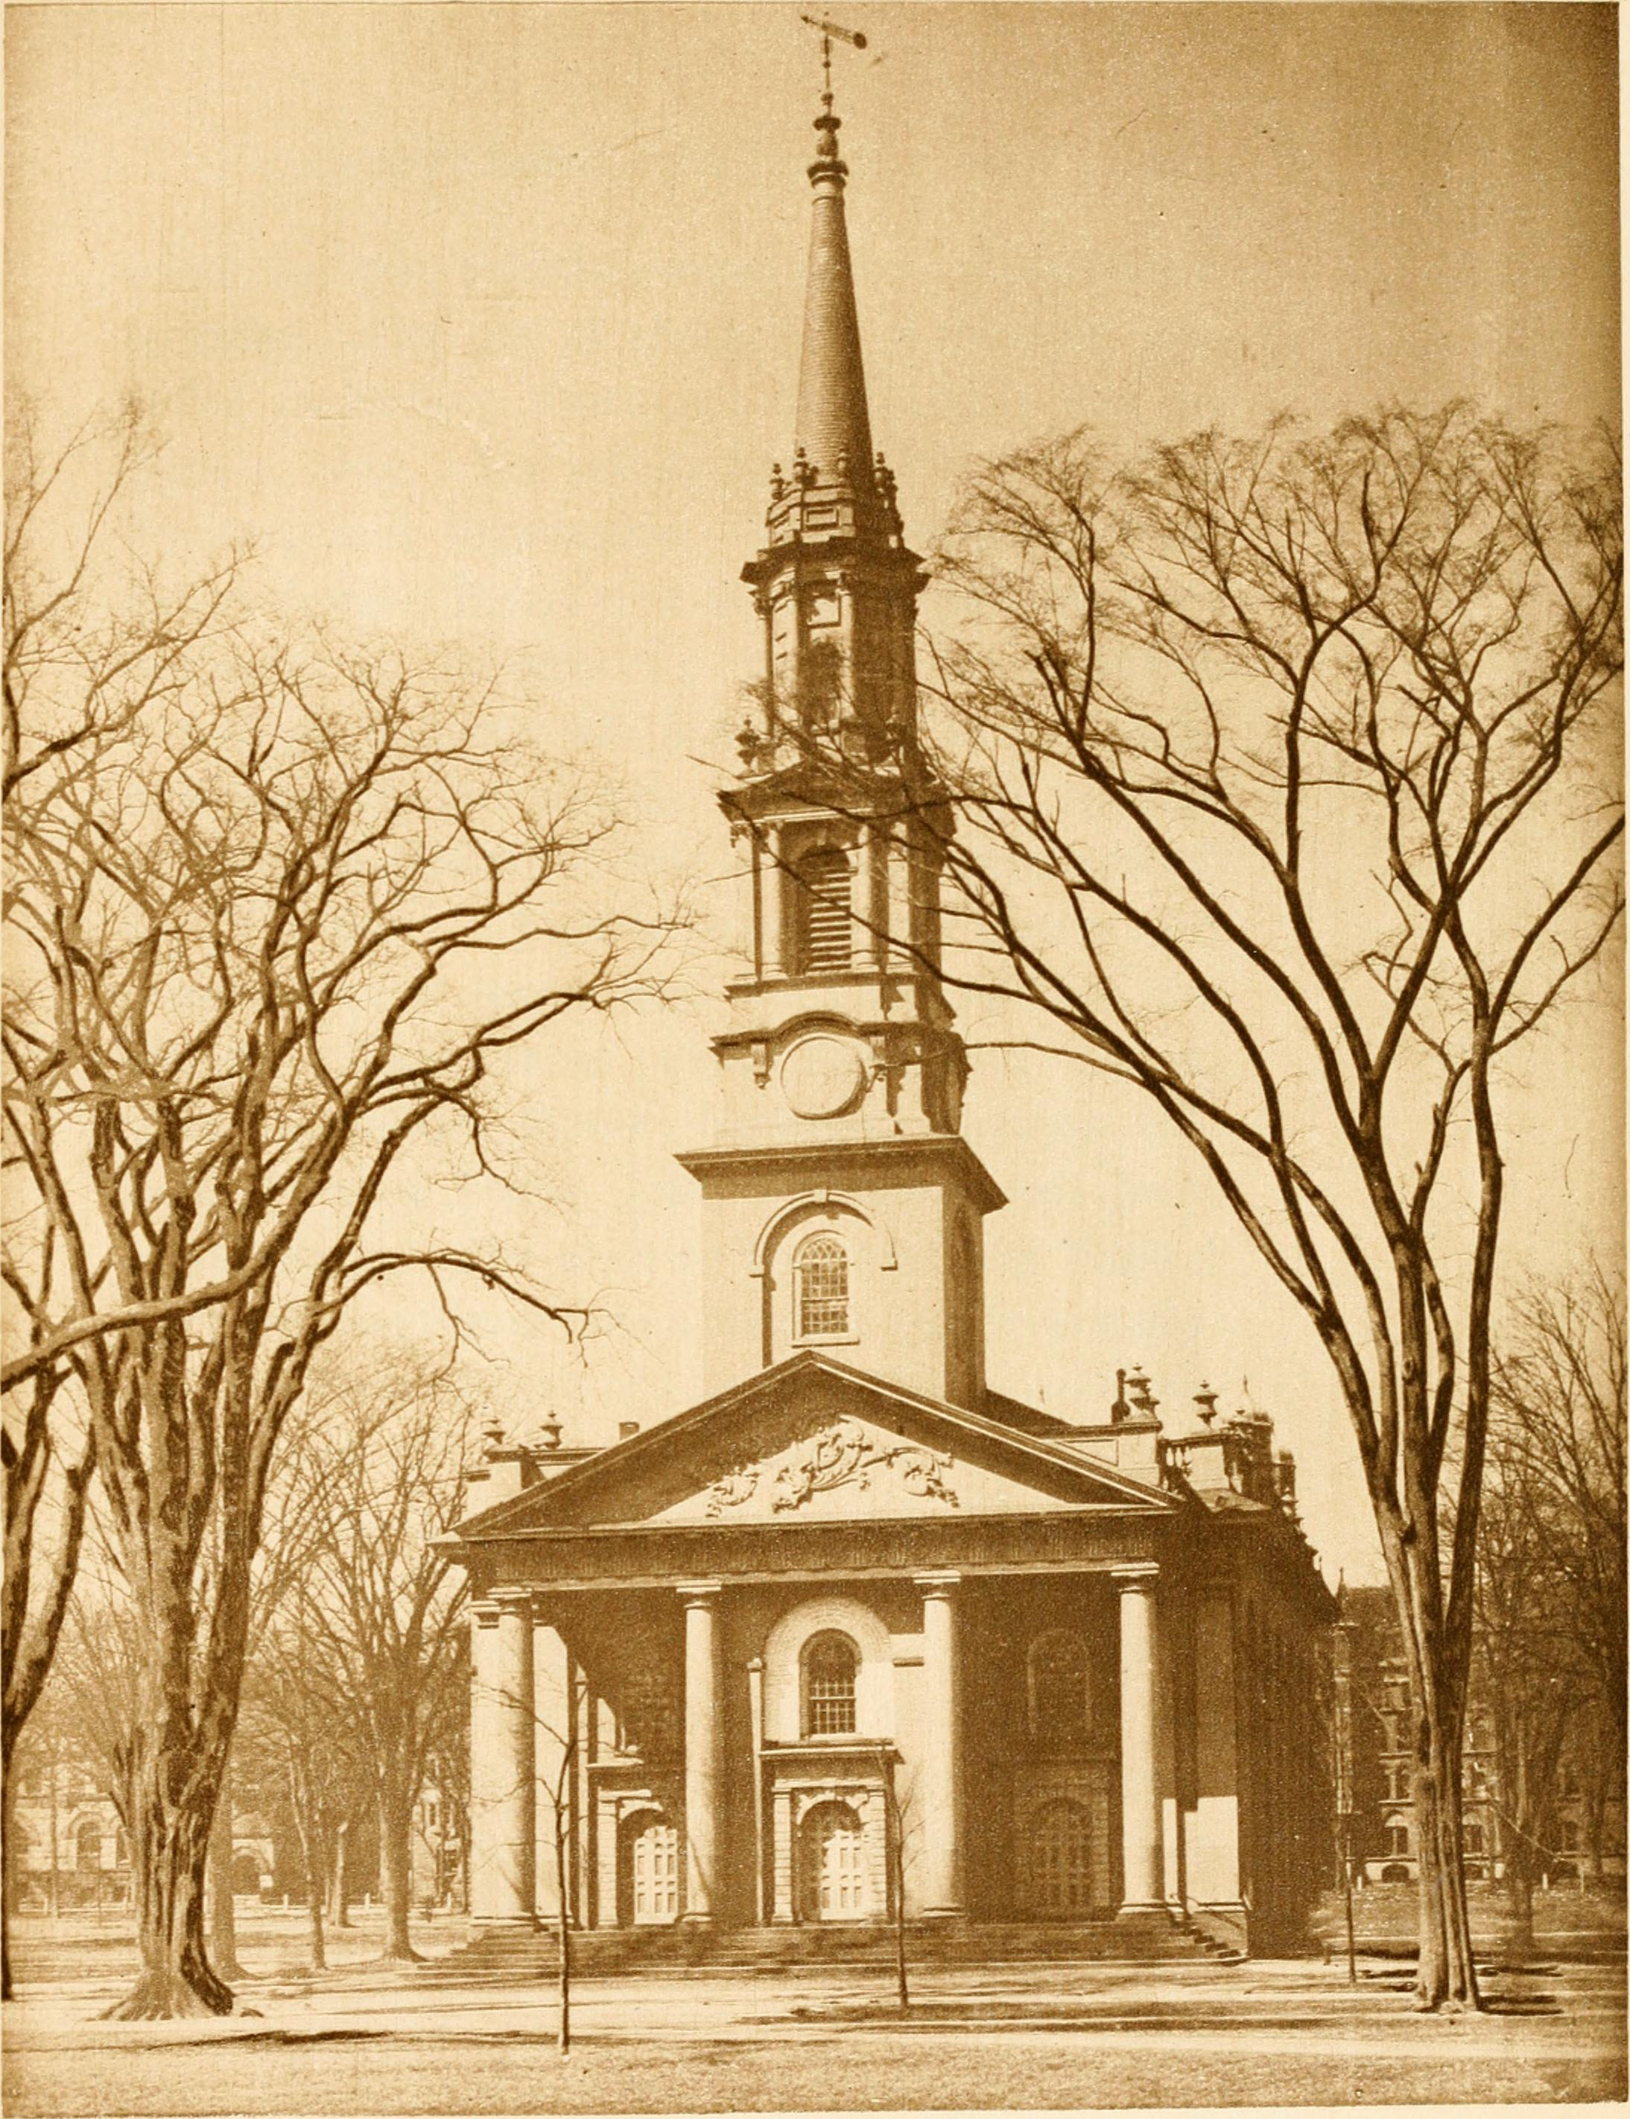
By the late 1600s and early 1700s, Puritan political control was ending. Many new colonists were not as interested in religious faith as much as previous generations.

Slide 20
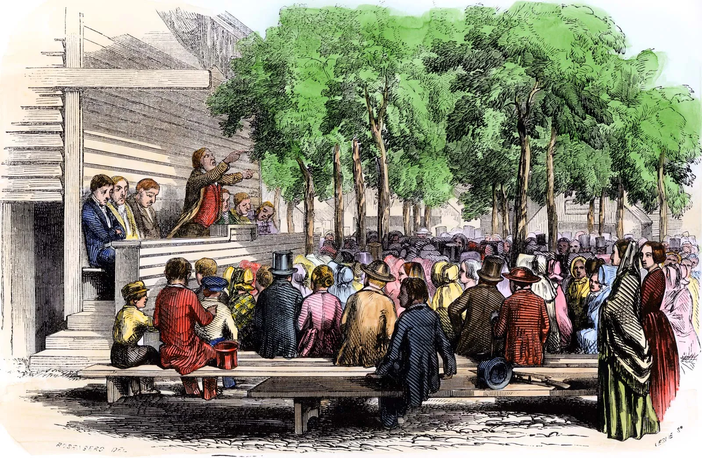
In 1720 only 25% of the people of New England belonged to a church. This began to change around 1740 when a new religious movement called the Great Awakening started.

Slide 21
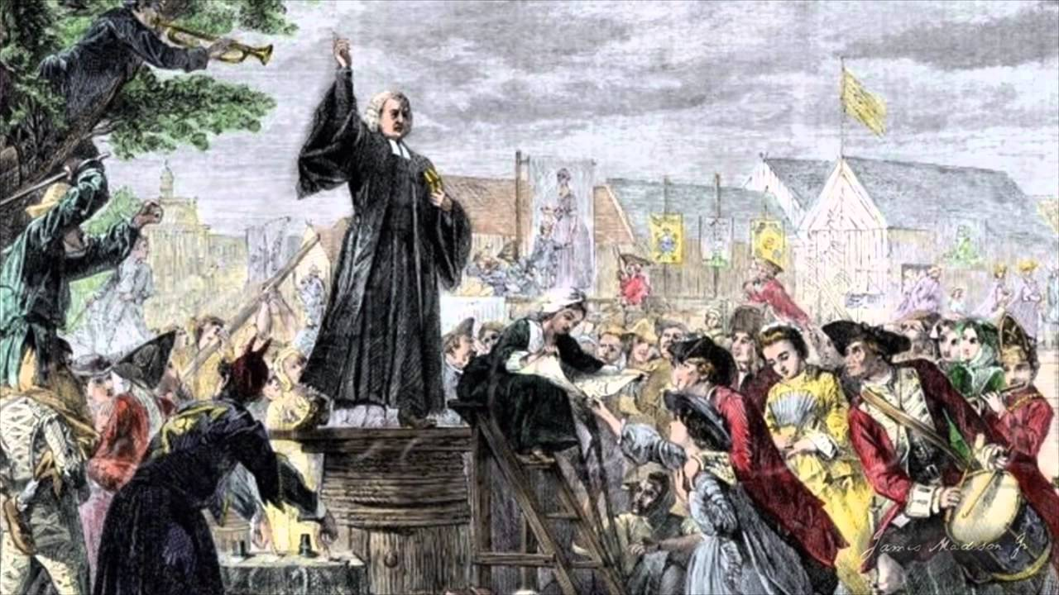
During the Great Awakening, ministers went from town to town holding revival meetings and urging people to return to their faith. Many colonists responded.

Slide 22
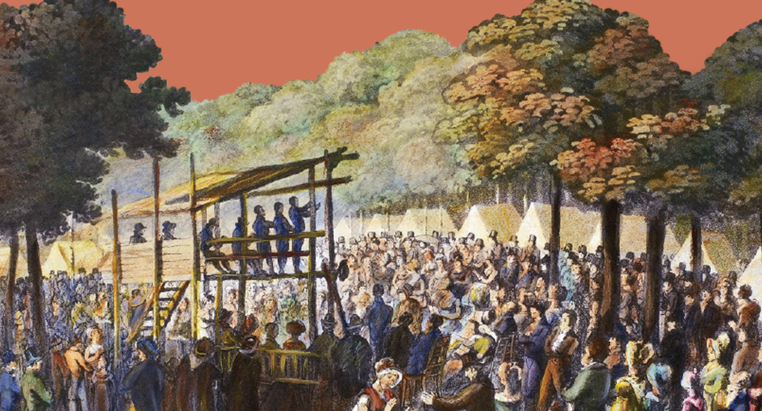
Not only did the Great Awakening return many people to the church, it also gave Americans a sense of equality. Everyone was seen as equal in God’s eyes.

Slide 23
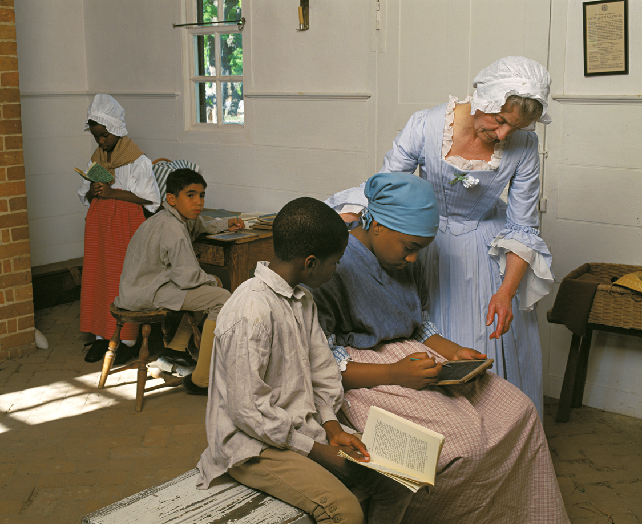
The Great Awakening also encouraged people to reach out to African Americans and Native Americans.

